Slide 1
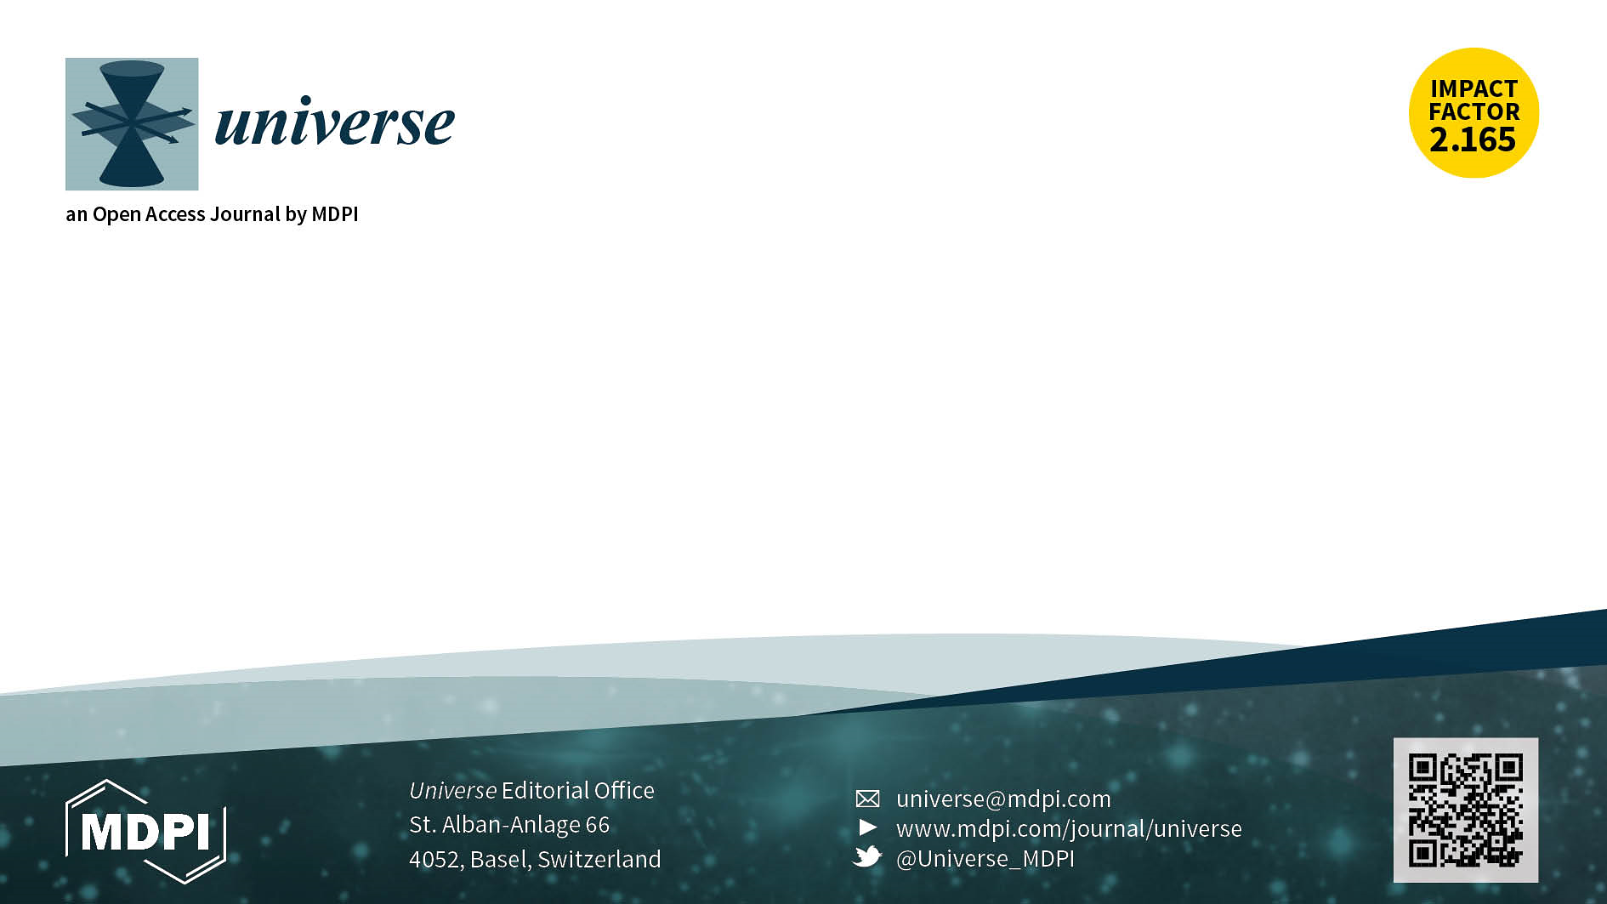

Special Issue (https://www.mdpi.com/journal/universe/special_issues/VIA_Astroparticle_Physics)
Project of the Virtual Institute of Astroparticle Physics (VIA)
The recent exciting progress in precision cosmology and cosmic ray physics (high energy gamma and charged particle) as well as the forthcoming developments in particle physics (LHC) and multimessenger astronomy involving, together with the observation in the whole range of electromagnetic spectrum detection of gravitational waves, cosmic-ray components and neutrinos, promise a large amount of new information and discoveries in the coming years.
The results of these experiments have a direct impact on the development of astroparticle models, which also give direct feedback to the running experiments for the search of new effects or particles following from these models.
Theoretical analysis of these results will have an impact on the fundamental knowledge on the structure of the microworld and universe and on the fundamental physical laws of nature.
The Virtual Institute of Astroparticle Physics (VIA) aims to support the development of this rapidly developing field.
Special Issue Editors:
Prof. Dr. Konstantin Belotsky
Prof. Dr. Vitaly Beylin
Prof. Dr. Maxim Yu. Khlopov
Prof. Dr. Dmitri Semikoz
Submission Deadline: 31 July 2021

Slide 2
Aims and Scope
1.752 Impact Factor | 2.4 Citesore
37 days Median Processing Time | 3 days Acceptance to publication (median values for papers published in this journal in May 2020)
Universe (ISSN 2218-1997) is an open access journal that publishes regular research papers, reviews and communications covering principles and new discoveries in the universe.
Website: https://www.mdpi.com/journal/universe
Email: universe@mdpi.com

